Slide 1
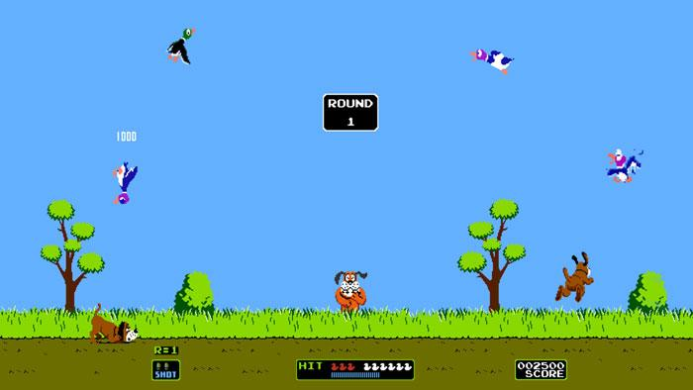
Duck Hunt
Drew Gray
David Freiberger
Sarah Anderson

Slide 2
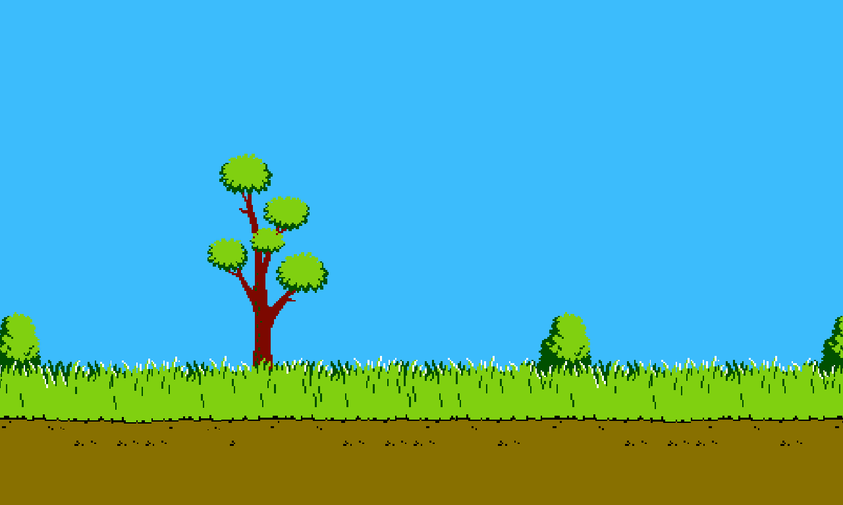
Roles, General Overview
David: Overall Coding Structure; Duck Movement, Hitbox, RGB/BMP artwork, structure of game, Duck BMP, Background Picture
Drew: Overall Logistics; Mouse Recognition, scoreboard Input, Virtual Keys, RGB conversion of Background Picture, hit recognition, sound effects
Sarah: BMP images

Slide 3
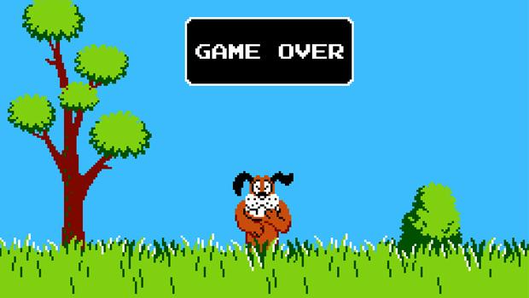
Questions?

